Slide 1
Microsoft Power Automate Empowerment
Notes:
Hi, Welcome to Microsoft Power Platform + Dynamics 365 Bootcamp.

Slide 2
Course Overview
Day 1
Empowering everyone with Power Platform
Day 2
Power Automate Introduction
Day 3
Power Automate Project Scenarios
Day 4
Monitoring & Administration of Power Automate
Introduction to Power Platform
Microsoft Power Platform momentum
Why Power Platform?
Customer Stories
Power Platform Components Demo
Power Platform Account Setup
Microsoft Flow Basics
Microsoft Flow Templates
Decision Making with Flow
Conditions, Switches, Scope & Context of Decision-Making Control Elements
Building Workflows with Power Automate
Hands on Lab - Microsoft Flow
Approve / Reject Workflow Scenario
Recurrence Workflow Scenario
Errorless workflows Scenario
Build and Implement Custom Connector
Azure Cognitive Services AI Integration Workflow Scenario
Power App Integration Workflow Scenario
SQL Server Integration Workflow Scenario
HoL - End to End Business Flow with all Scenarios
UI Flows
Import, Export Flows
Distribute Flows
Sharing of Flows across workspaces
Different Flow Environments and Code Promotion
Data Policies & Integration Check Points
Flow History and Analytics
HoL - Check your Knowledge

Slide 3
Day2:Power Automate

Slide 4

Agenda
Microsoft Flow Basics
Microsoft Flow Templates
Decision Making with Flow
Conditions, Switches, Scope & Context of Decision-Making Control Elements
Building Workflows with Power Automate
Hands on Lab - Microsoft Flow

Slide 5

Where we come from
Microsoft has not released any new versions of the SharePoint designer after SharePoint designer 2013, no new designer for SharePoint 2016, SharePoint 2019 or SharePoint Online. In workflow architecture also, there are not many changes for any version. Rather Microsoft has invested heavily on Microsoft Flow to provide an alternative to designer workflows (this is not officially announced by Microsoft, but has been assumed based on the functionality provided in Microsoft flow).
Microsoft Flow is nothing but a service which helps to create an automated workflow for your business needs. This Microsoft Flow is a replacement to SharePoint Designer. That means, Instead of Designer Workflow, Now we can simply create a Microsoft Flow and we can use it as per our requirement. Microsoft Flow is basically used to allows users to create cross-application workflows..

Slide 6
Introduction

Slide 7

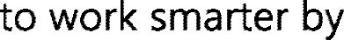



What is Power Automate?

Slide 8
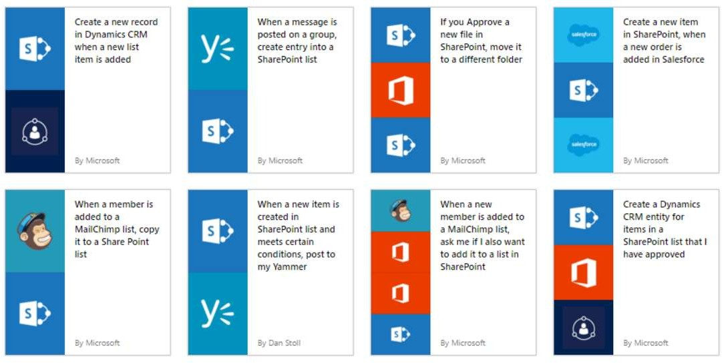
GET STARTED
https://flow.microsoft.com
Source: Microsoft

Slide 9
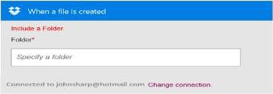
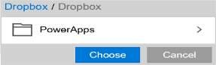
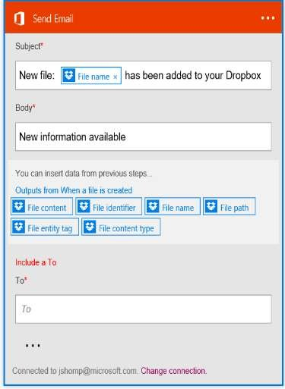
Build your own flows in an easy to use visual designer
Sending an Exchange email when a new file
is added in Dropbox
PowerApps
Authenticate to your Dropbox account.
Select folder to monitor
Choose to include properties from previous step (Dropbox file) to improve relevance
Authenticate to your O365 account.
Build email Subject and Body
Specify Send To email address and additional properties (optional): From, CC, BCC and Importance
Source: Microsoft
Connected to johnsharp@contoso.com

Slide 10
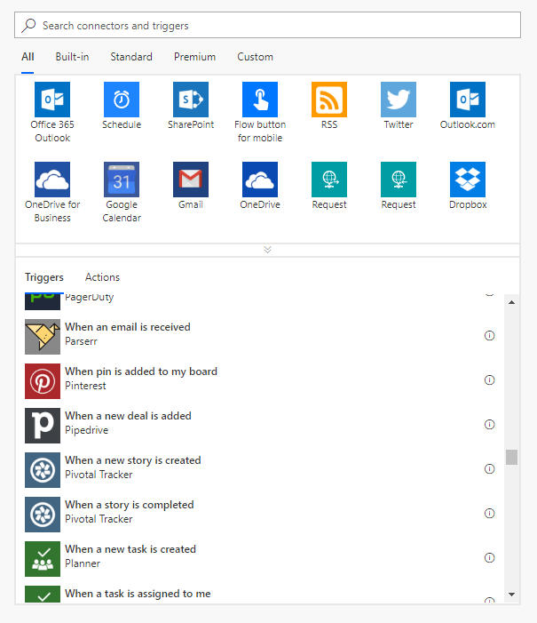
Types of Flows
Scheduled flows
Automated flows
Instant flows
Business process flows

Slide 11
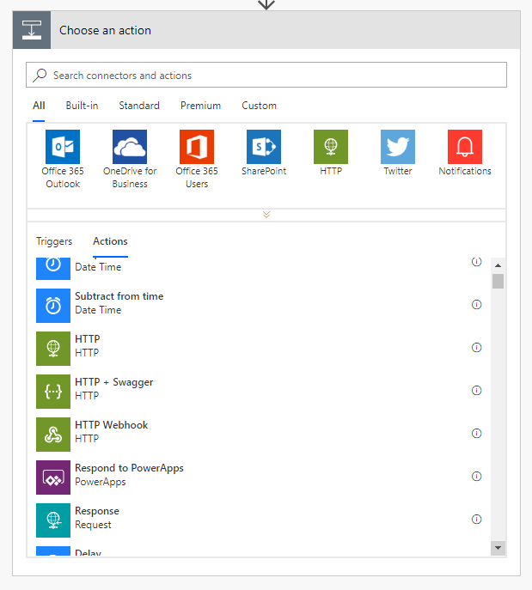
Actions in flows
1+ steps that run after the trigger
Connect to cloud service or on-prem via the on-prem data gateway
Directly connect to HTTP endpoints if there’s no out-of-box connector
Some actions may not even use connections – just manipulate data locally
Custom connectors connect to your own cloud or on-prem REST services

Slide 12
Flowing data
Trigger
Outputs:
File name
Size
File content
Data ‘flows’ from each step and is available for all later steps
Use Add Dynamic Content to select outputs from previous steps
Input types are matched to output types to show a subset of outputs by default
Expressions can be used to convert between data types or calculate derived values
Action 1
A binary field would see:
File name
Size
File content
Outputs:
Title
Count
Action 2
A string field would see:
A number field would only see:
File name
Size
File content
Count
Title
Size
Count

Slide 13
Data types and expressions

Slide 14

Using expressions
Many reasons to use expressions:
Convert types
Perform simple, inline calculations like string manipulation or arithmetic, or date/time manipulation
Generate data like the current time, a GUID or a random number
Handling optional values
“If” conditional statements / control flow
Working with lists
?

Slide 15
How to create expressions
1
Add Dynamic Content
Dynamic content
Dynamic content
Expression
2
Expression
fx
replace(body('Get_record')?
OK
Action name
3
Inputs
fx
replace(…)

Slide 16
Anatomy of an expression
fx
replace('Title: placeholder', 'placeholder', 'Flow')
Expression name: replace
One or more parameters, separated by commas
Use single quotes around static text
Include expressions in other expressions

Slide 17
Other expressions
body(stepName)
Returns an object with all properties of a different action
triggerBody()
Like body() but for trigger output.
item()
Used to reference the current item in Apply to each
Also used for actions that take an array and manipulate them
variables(variableName)
Reference a variable

Slide 18
Data types and formats
Strings – aka text
Normal – 'Example string'
Email, URL, phone number, etc…
Base64
Binary content
Data URI
URI component
For strings use single quotes
Non-text
Floating-point number – 9.0
Integer number – 137
Boolean – true or false
Array – a list of items
Object – a record with key-value pairs
Do not use single quotes for numbers, integers or Booleans:
'true' does not equal true
[ ]
{ }

Slide 19
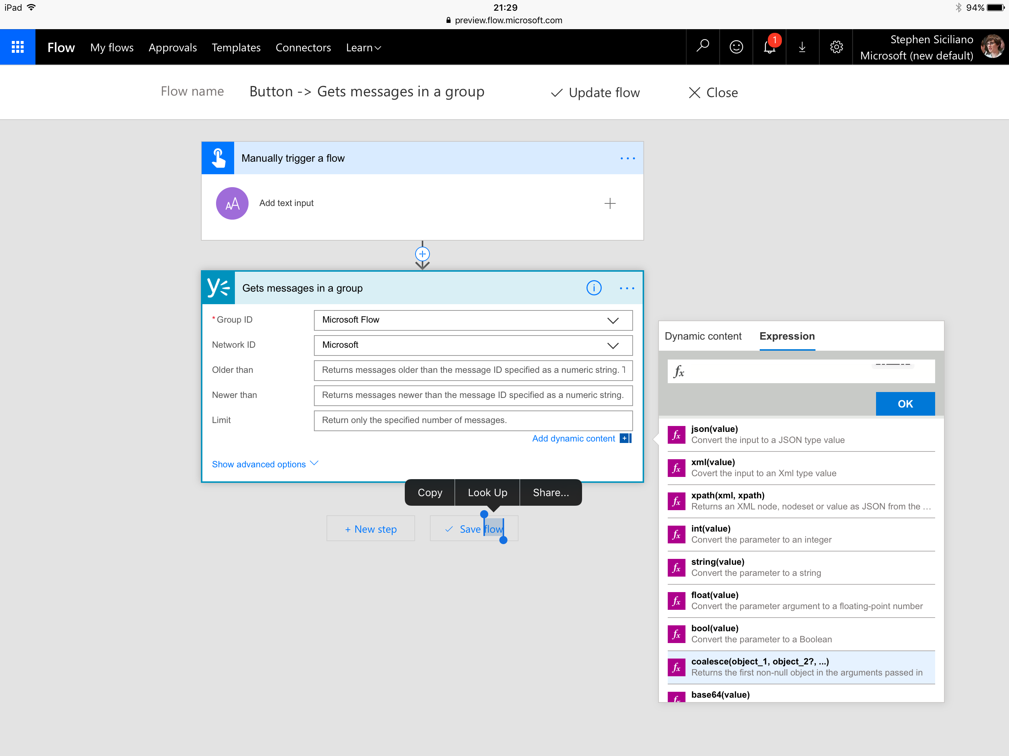
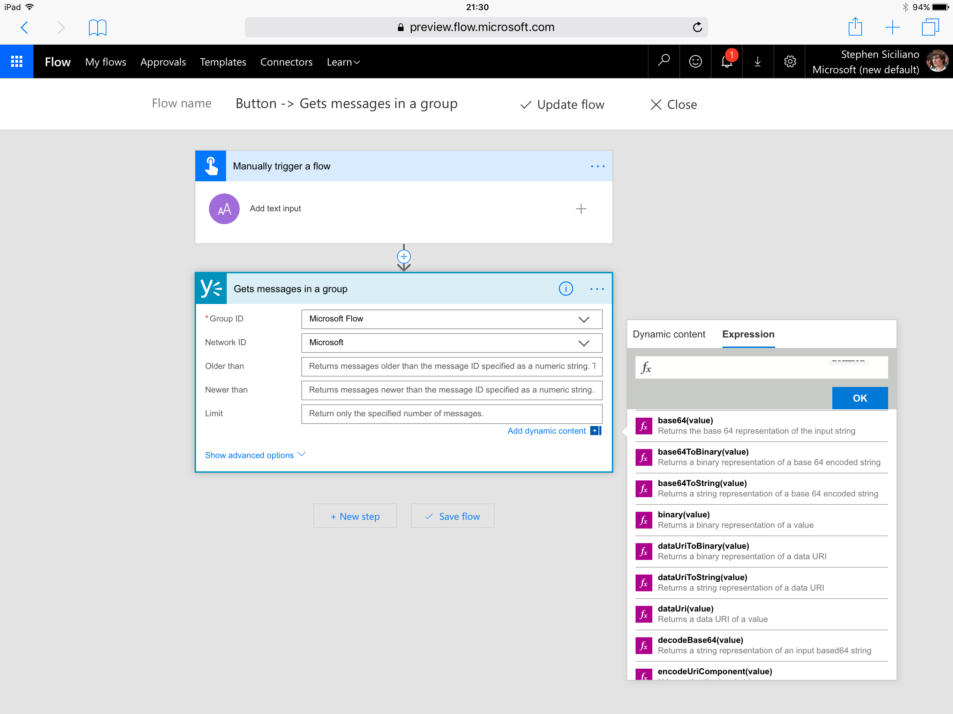
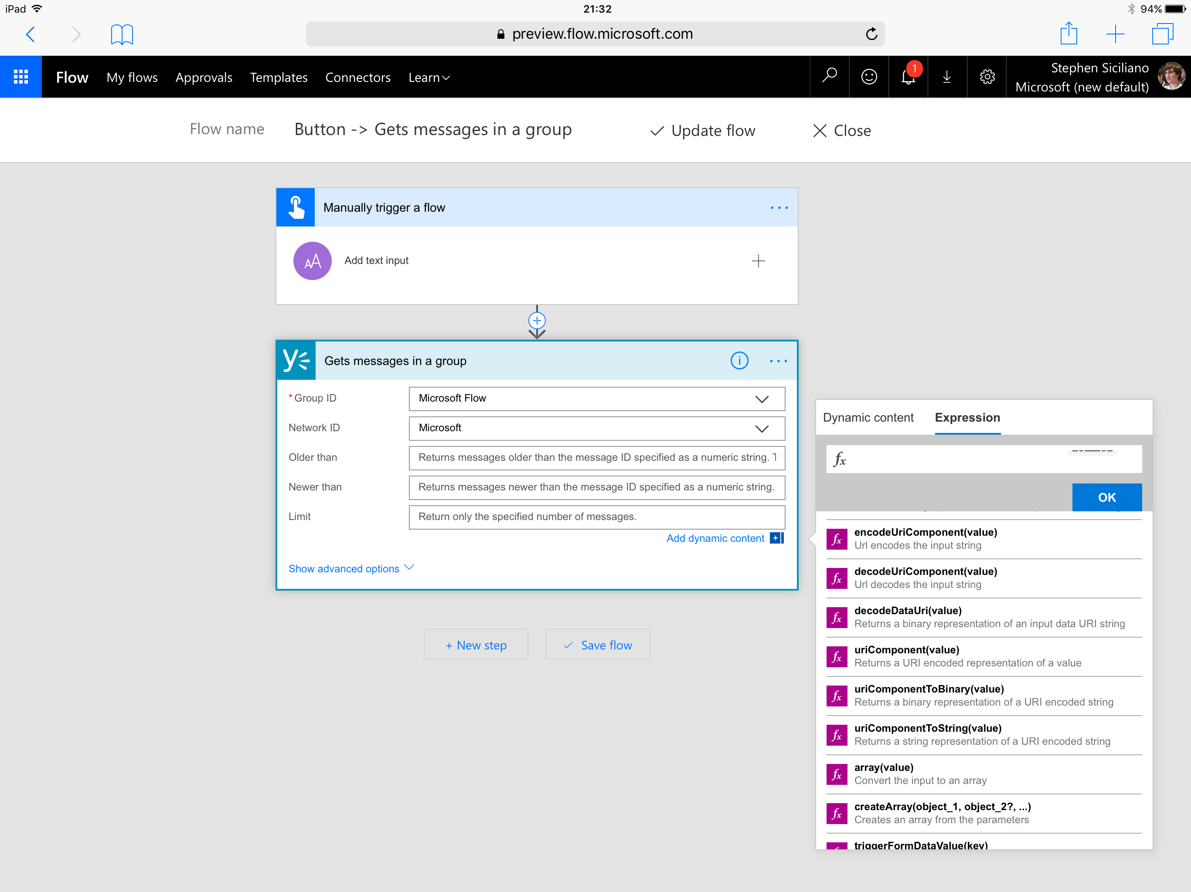
Handling content conversion
Some conversion is automatic (i.e. integer input into string field)
In some cases, a conversion expression is automatically added by the UI
Other conversions you’ll need to author an expression for directly
The expression is named for the destination type
For example to convert to base 64, use the base64() expression

Slide 20
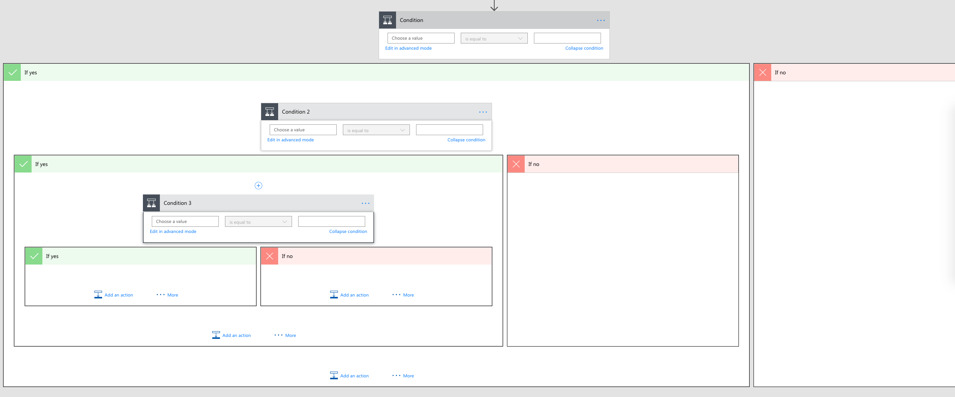
The if() expression
Why use the if() expression if you can use a condition?
Avoid multiple nested conditions just to set a field
Caution: The if does not ‘short circuit’ which can result in errors if you try to reference a missing property in one branch

Slide 21
Handling optional values
Caution: trying to use a property that’s not set – aka “null” -- will cause the flow to fail
Two steps to handle:
Use the “?” character after selecting the property (this happens automatically). Use when chaining access to sub properties.
Then, use the coalesce() function to provide a default value
coalesce(body('Get_record')?['parent']?['child'],'Default Value')

Slide 22
Working with Arrays

Slide 23
What are Arrays?
A few different classes of things you may need:
Repeat an action over each list item
Get a single item from a list
Filter a list down
Make a list work with a different action
Jane
8.29
ID: 123
Name: Jane
Mail: J@a.c
Dan
4.89
ID: 888
Name: Bob
Mail: B@a.c
Steve
0.28
ID: 456
Name: Dave
Mail: D@a.c

Slide 24
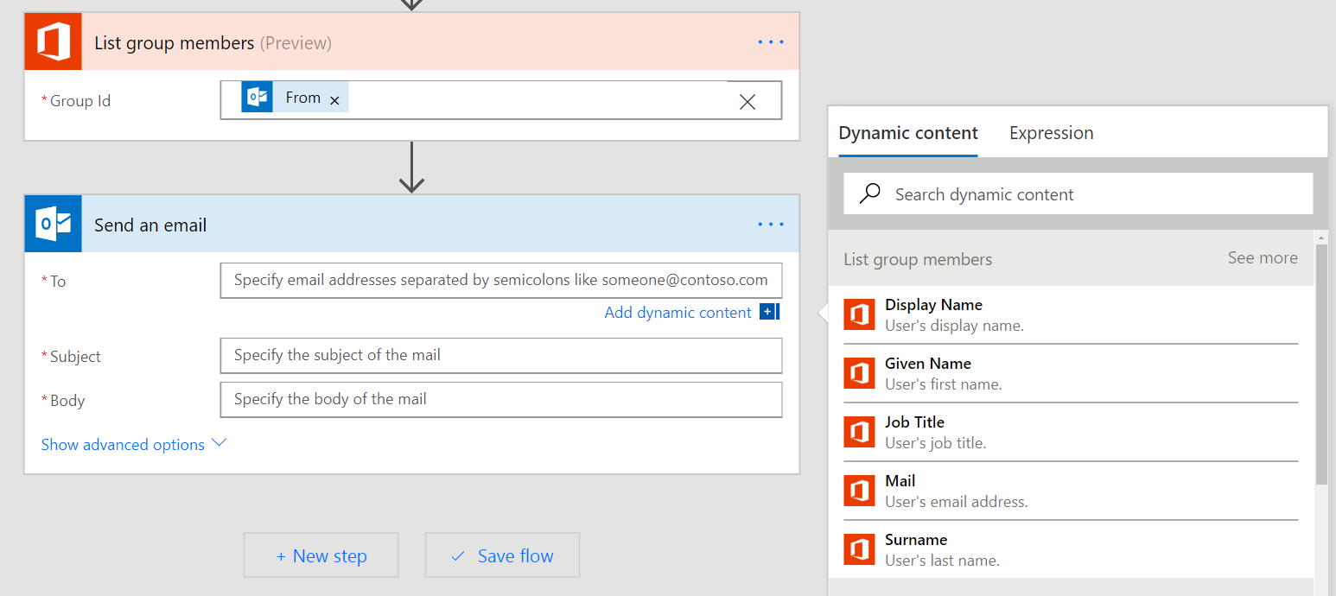
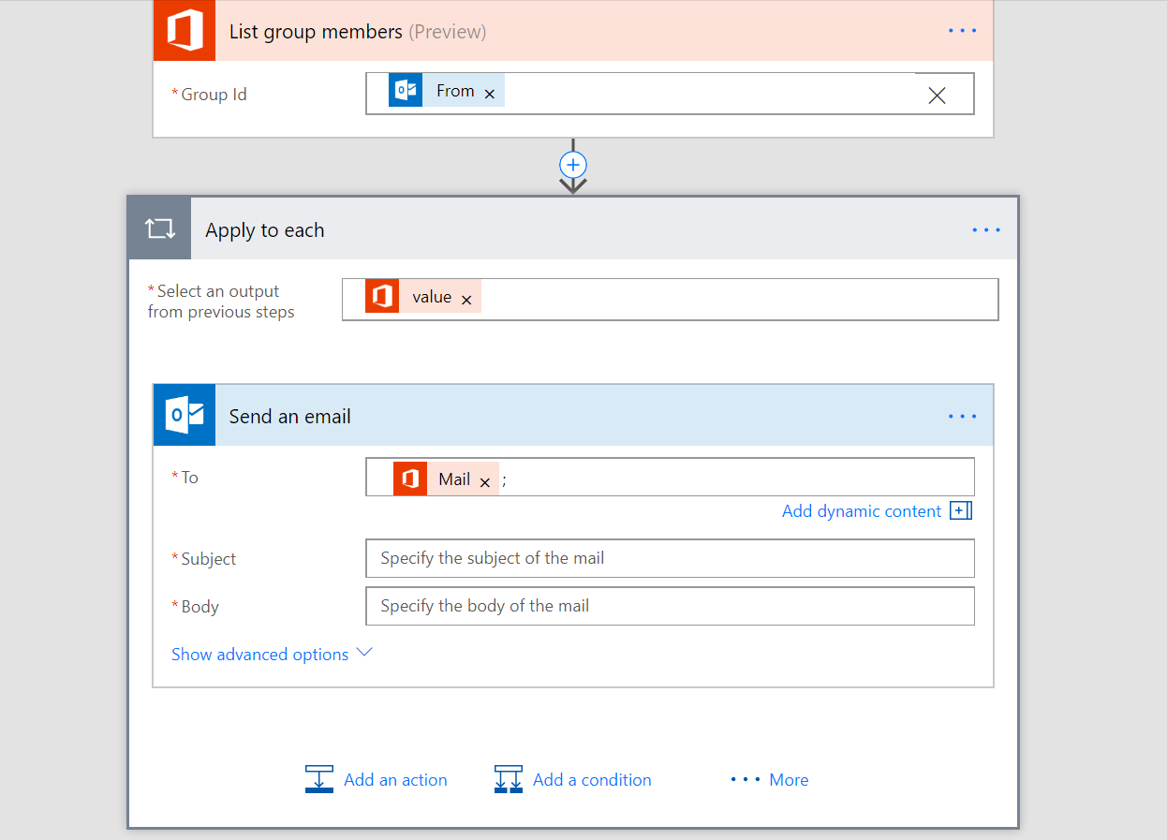
Apply to each
Automatically added when you try to use an output that’s part of a list
Destination step to repeats over every list item
If you do NOT want this, you can:
Get only one list item using an expression, or,
Convert the whole list to a string in the form of a list or a table

Slide 25

Getting certain list items
0
Use the first() expression to get the first item from a list
Use square brackets and a number (starts at 0) to get a certain item, for example [2]
Use the last() expression to get the final item
1
2
3
Note: If the array is a list of Strings, Numbers, Booleans etc…, then the above expression can be used directly. However, if it is an array of objects, you will need to use square brackets to select the specific property you need:
last(body('Get_rows')['value'])['mycolumn1']
body('Get_rows')['value'][2]['mycolumn1']

Slide 26
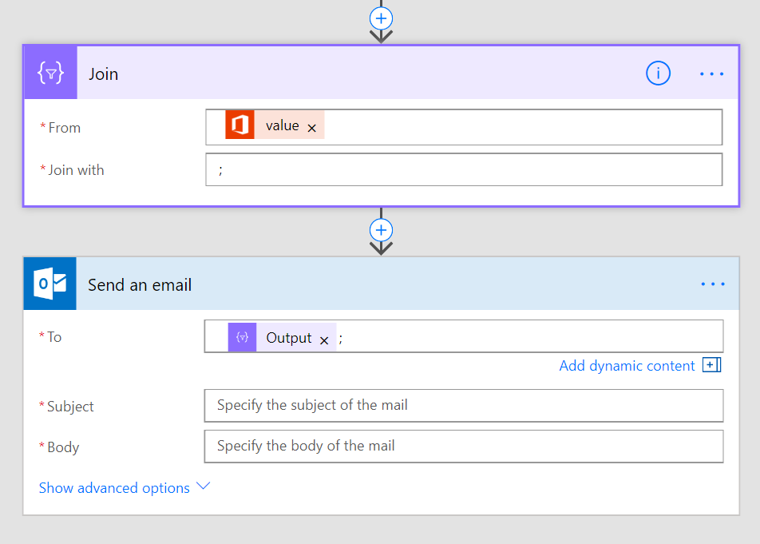
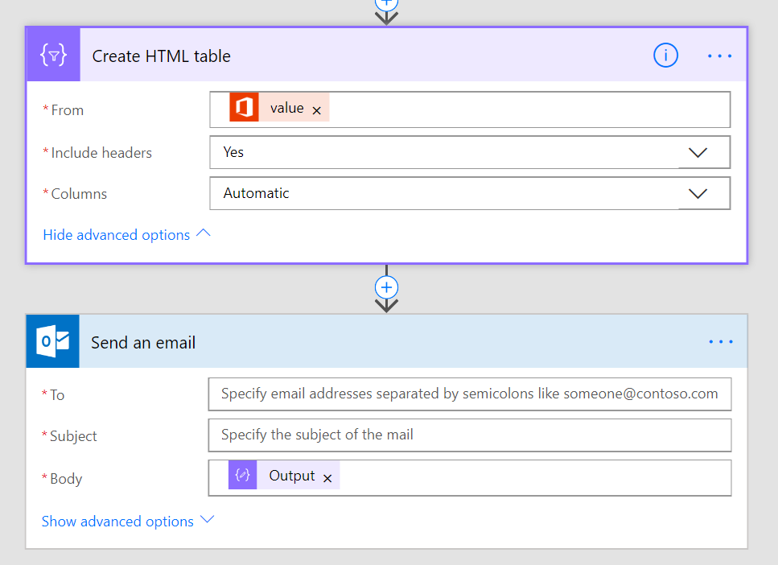
Convert the list to a string
Join – use join to get a simple list, for example, if you have a list of email addresses*
Create HTML/CSV Table – convert a list of Objects to a tabular display format, for example, for inclusion in the body
* Note: You must have a list of strings, not a list of Objects. Use Select if you want a sub-property of each object.

Slide 27
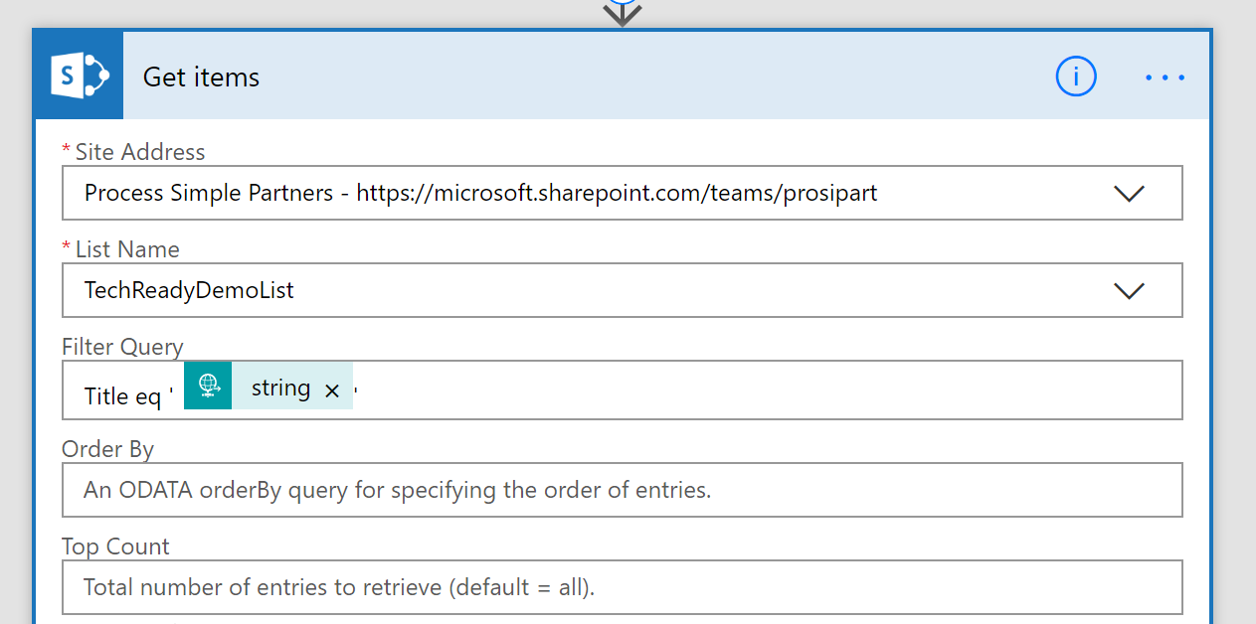
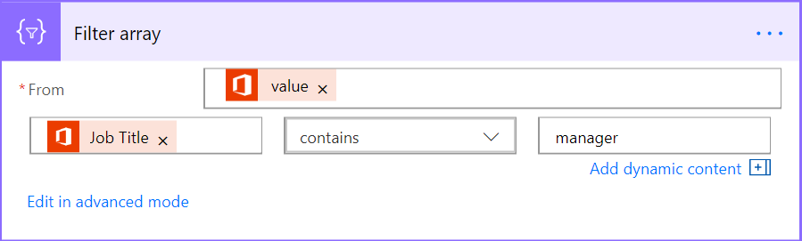
Filtering
Ideally – have the connector do the filtering for you
Requires use of OData syntax and is limited. Read more here.
Built-in Flow action – Filter array
Select the Array in the From field
Can either use simple or advanced mode just like for Conditions
If you need the first N items, you can use take() or skip()

Slide 28


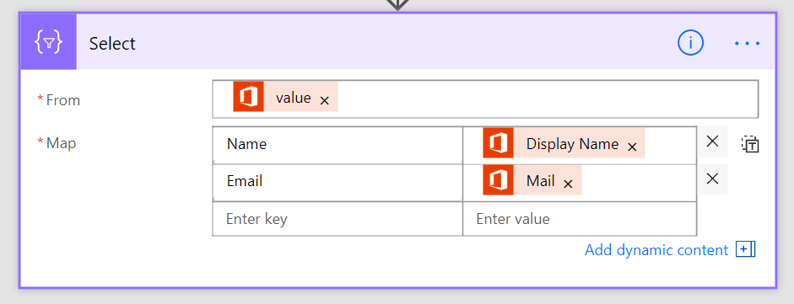
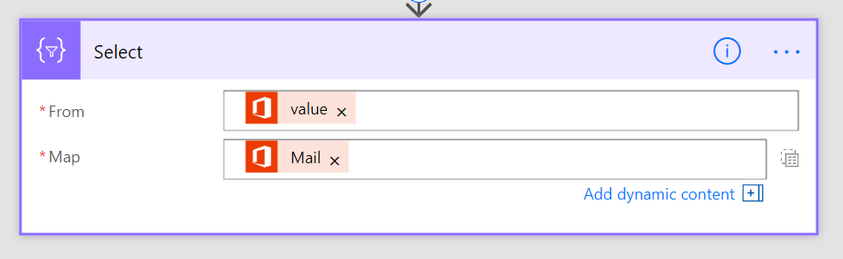
Transforming Arrays
Two input modes: fill key-value pairs, or typing expressions directly in
Create an array of objects
Create an array strings, numbers, booleans, etc…
Useful for passing this Array to another action
Useful for getting a simple list, for example, of email addresses

Slide 29
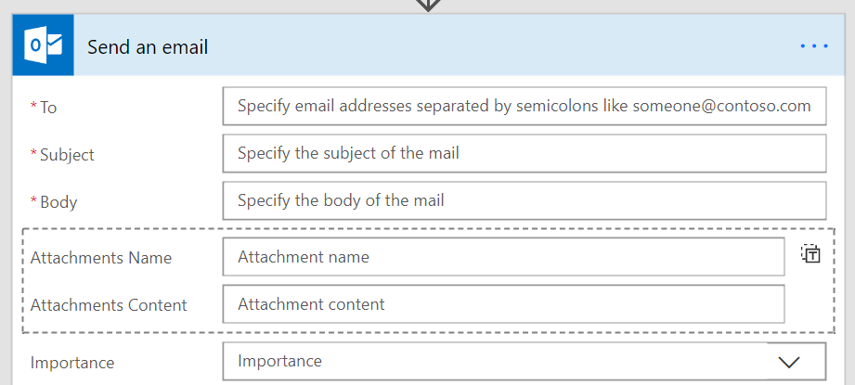
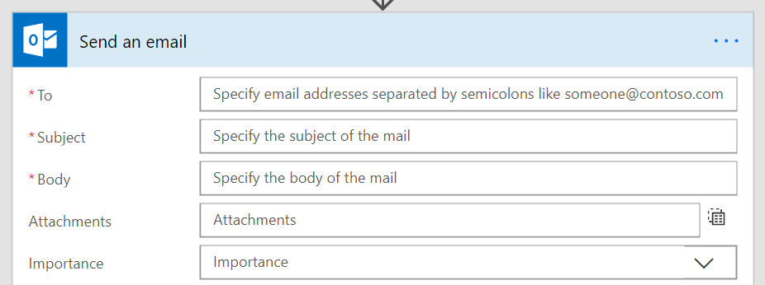
Passing data into arrays
Can hardcode a list – or – have the list be dynamic at runtime
Fill in each property of the object and get one item created
Need to pass in an Array that exactly matches the fields

Slide 30

Checking list containment or duplicates
You can use the contains() expression to see if something is in an array
Use the union() function with the array twice to get a set of unique items

Slide 31
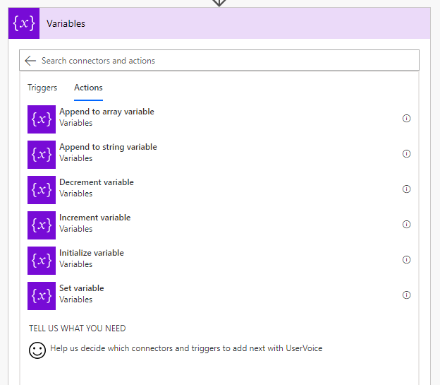
Variables
Define the type and initialize the variable before you use it.
Useful for:
Counters – you can increment or decrement variables
Append to arrays or strings
Set state, check it elsewhere in the flow
Simplify expressions – no need to keep checking object?[‘p1’]?[‘p2’]?[‘p3’]

Slide 32
Escaping rules
When you directly are using the expression language you may need to escape certain characters
Using strings with a single quote character:
@substring('It''s A Great Day!',1,5)
Using spaces in action names:
@body('Name_with_spaces')
Building an object you need to escape ‘@’:
{
"@@Odata.type" : ""
}

Slide 33
Control flow and action settings

Slide 34
Normal action execution
Run in sequence
Flow terminates once an error (failure or timeout) is encountered
Skipped means the previous action didn’t run
Summary: four possible states for an action:
Succeeded
Failed
Timed out
Skipped

Slide 35
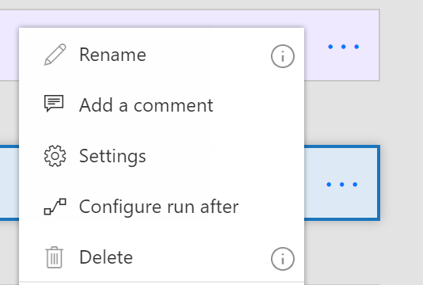
Action settings
The “…” menu contains entry points to Settings and Configure run after
Settings lets you configure:
Async Actions
Timeout
Retry policy
Sequential
And more!

Slide 36
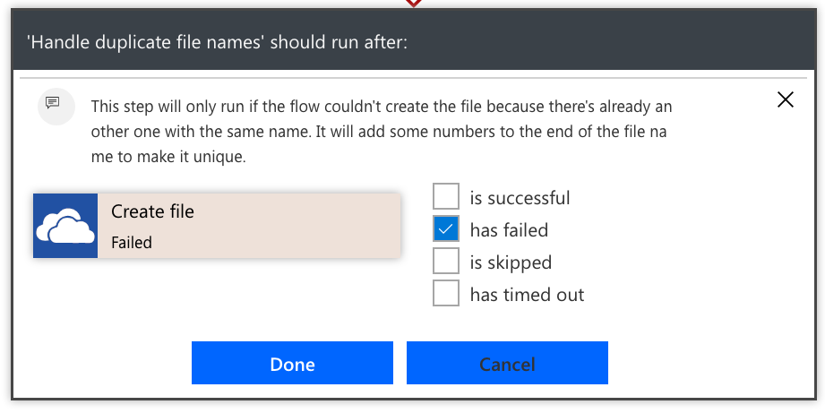
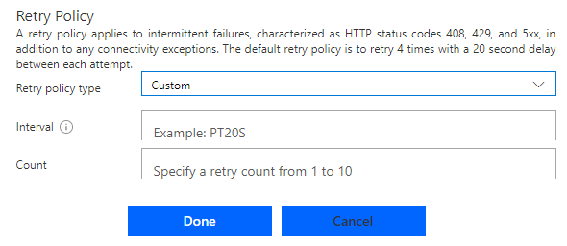
Error handling
Select the Run After option in the action menu
Choose which error conditions, the arrow will turn dotted red
Use parallels for errors that aren’t at the end of the flow
Retry policy by default handles transient failures
Recommended to choose exponential policies as they can go for a long period of time

Slide 37
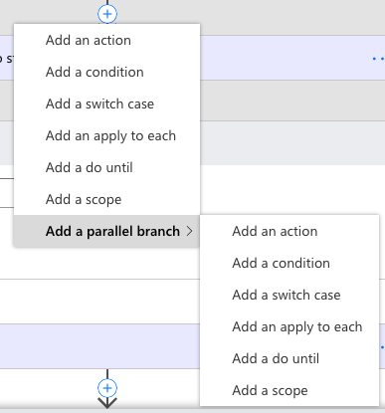
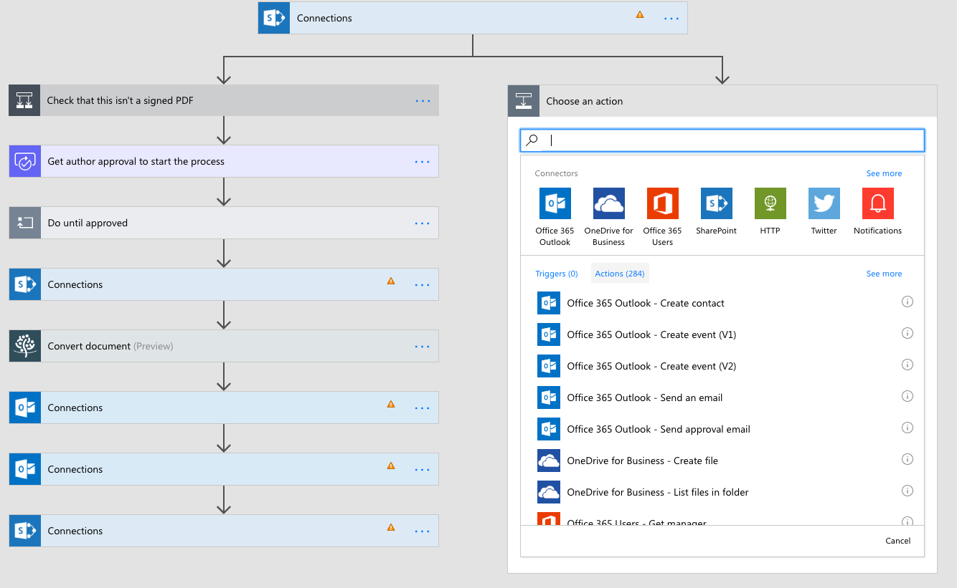
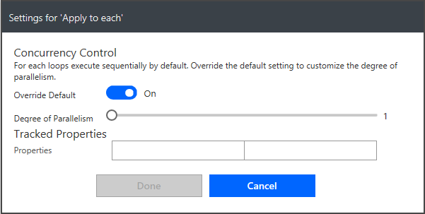
Parallel execution
For actions select Add parallel branch from the above the action
Inside of an Apply to each you can control parallelism

Slide 38
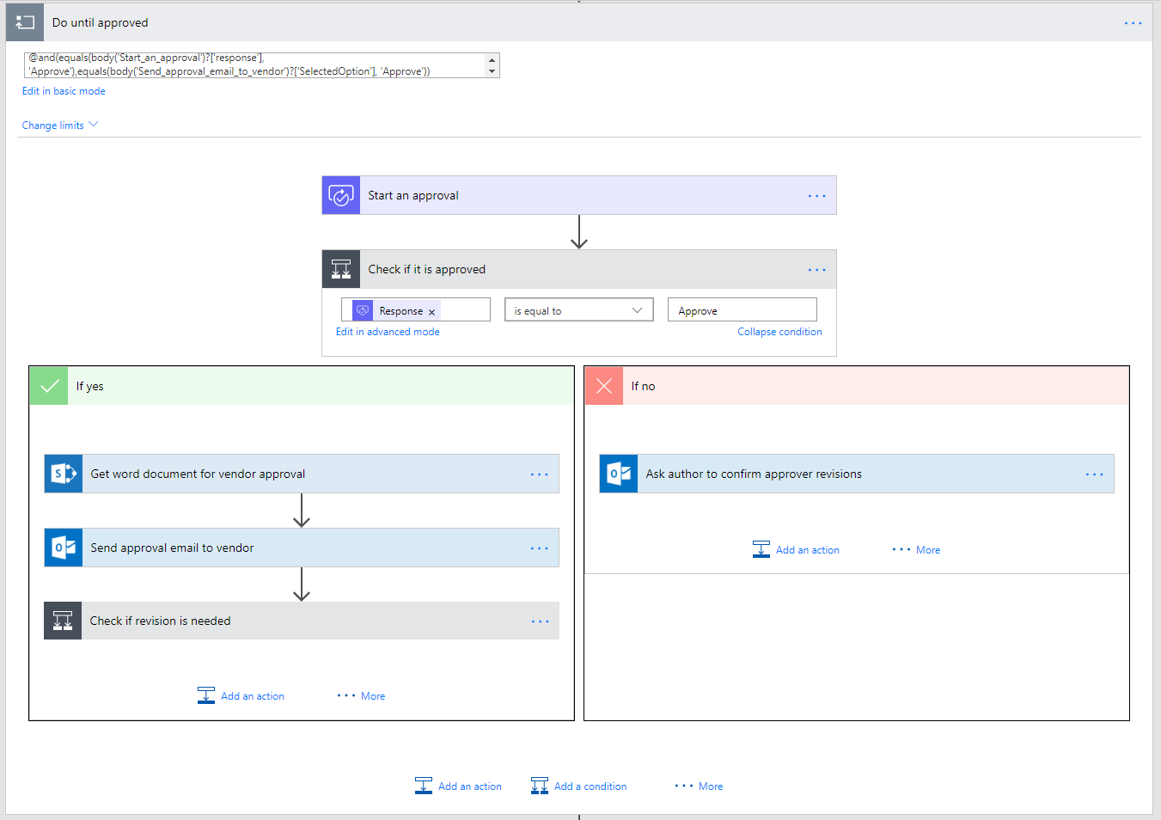
Looping
Stage 1 approval request
Stage 1 Approved?
Do until - actions that you want to repeat until a condition is met
Do something until condition
i.e. Do until an approval is completed
Caution: Executes at least once
Stage 2 approval request
Ask Author to make changes requested by Stg.1
Stage 2 Approved?
Ask Author to make changes requested by Stg.1
Revisions completed?
Mark document as approved

Slide 39
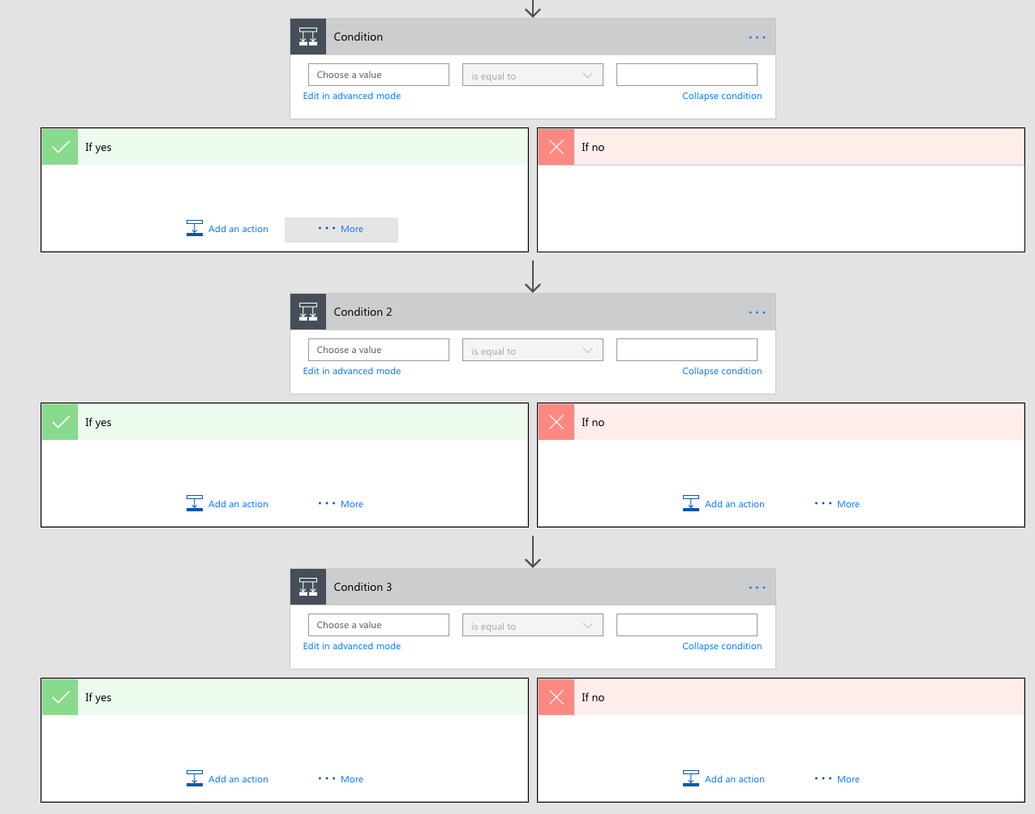
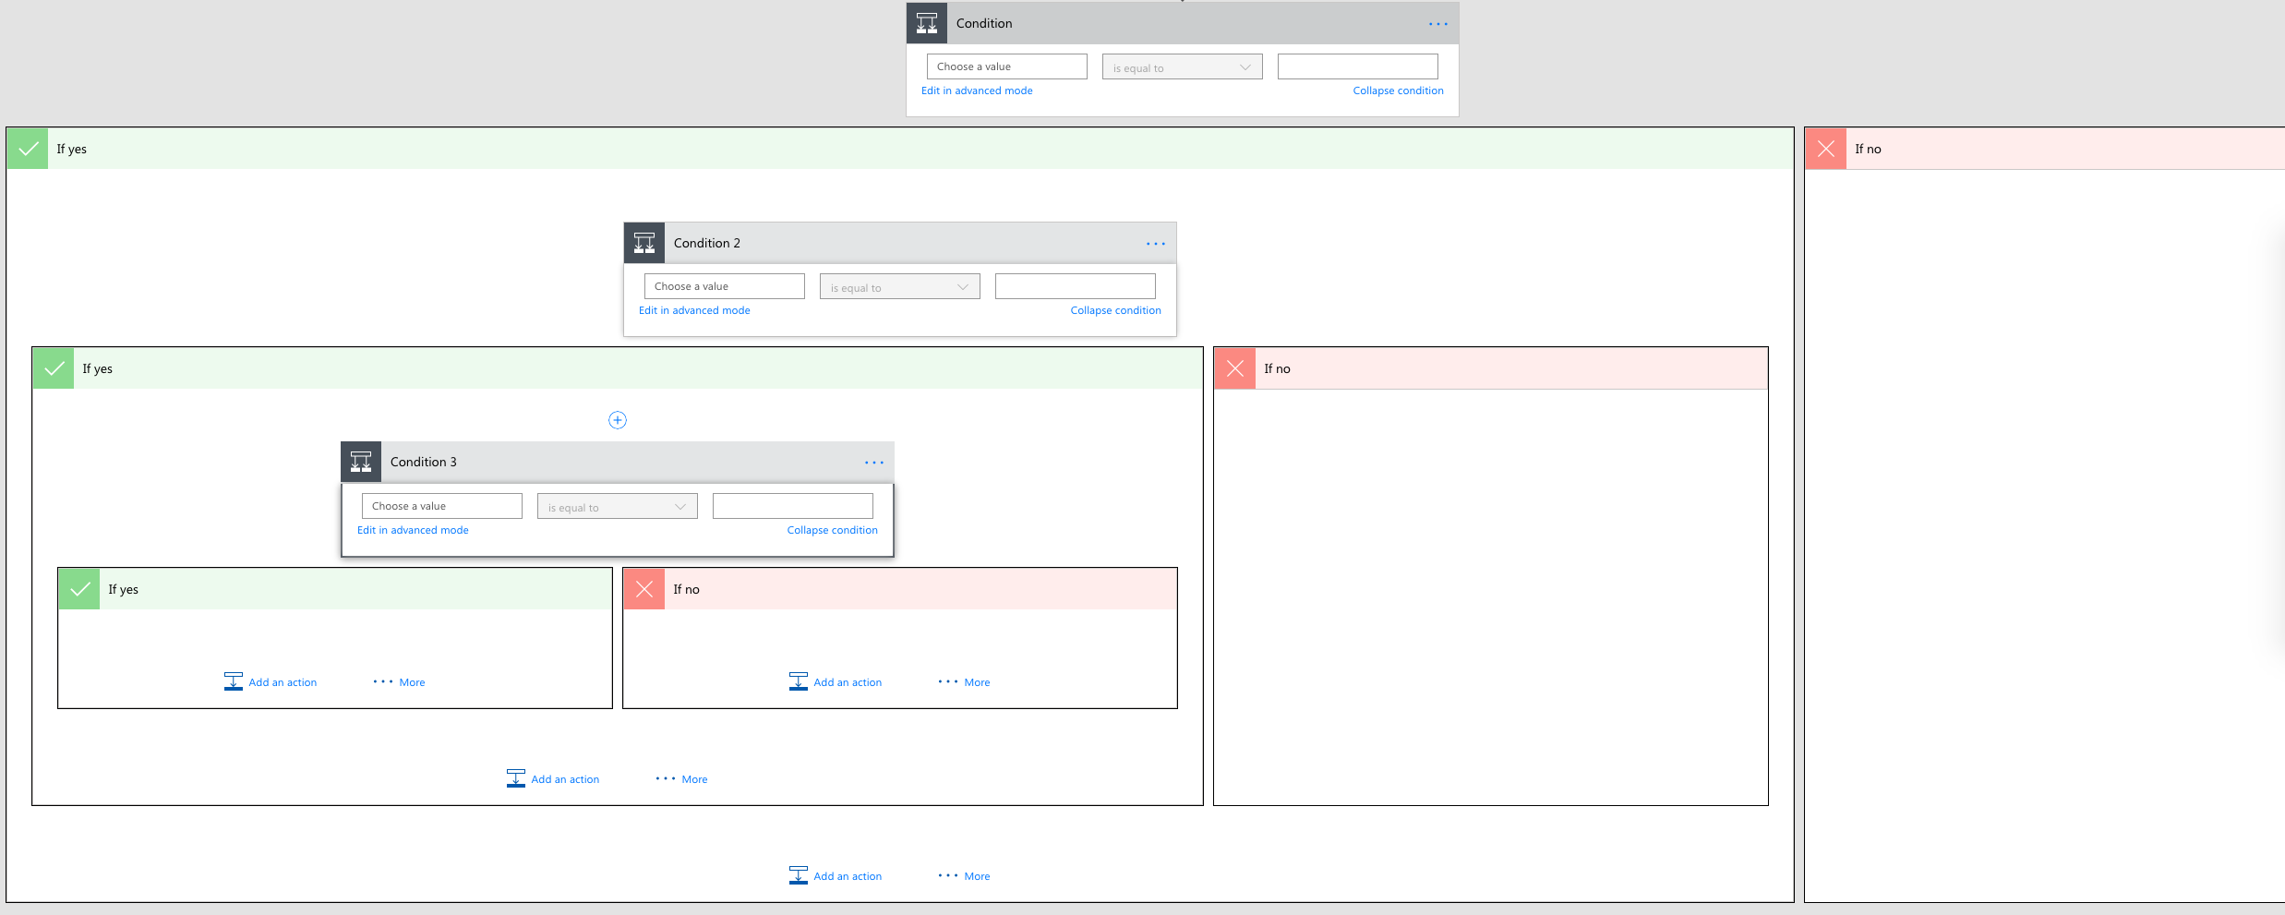
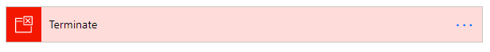
Terminate flows
You can use this action to avoid nested conditions by ending in the middle

Slide 40
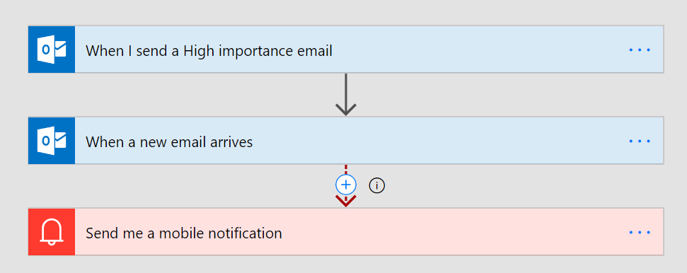
Asynchronous Actions
Any “trigger” can be in the middle of a Flow as well
For example, create a flow that waits for a reply to a certain thread in the middle
You probably want to configure a Time Out and handle that case
Do-Until might also be needed if other unrelated events may trigger

Slide 41

Demo

Slide 42
Customer Stories
Questions

Slide 44
Day 3 - Power Automate Project Scenarios

Slide 45












Jenkins NS
Modern Workplace Solution Architect | Consultant
Microsoft Teams, Power Platform and SPFx Specialist
International Speaker | Blogger | Trainer
SPS Bangalore Organizer
aOS Ambassador
jenkinsns@gmail.com
in/jenkinsns
@jenkinsns
http://www.jenkinsblogs.com
jenkinsns
https://www.facebook.com/spfxinfo/
https://www.facebook.com/msteamsinfo

